Slide 1
Informed Search Methods Tuomas Sandholm Computer Science Department Carnegie Mellon University Read Sections 3.5-3.7 of Russell and Norvig
Minor additions by Dave Touretzky in 2018.

Slide 2
“Heuristic”
Literally translates to “to find”, “to discover”
Has many meanings in general
How to come up with mathematical proofs
Opposite of algorithmic
Rules of thumb in expert systems
Improve average case performance, e.g., in CSPs
Algorithms that use low-order polynomial time (and come within a bound of the optimal solution)
% from optimum
% of cases
“probably approximately correct”
h(n) that estimates the remaining cost from a state n to a solution
We’ll assume that for all n, h(n) ≥ 0, and for all goal nodes n, h(n)=0.

Slide 3
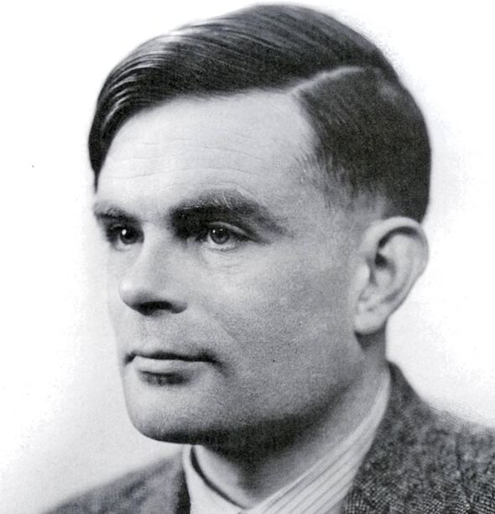
Uninformed vs. Informed Search
Uninformed
Informed
Can only generate successors and distinguish goals from non-goals
Strategies that know whether one non-goal is more promising than another

Slide 4
Best-First Search
function BEST-FIRST-SEARCH (problem, EVAL-FN) returns a solution sequence
inputs: problem, a problem
EVAL-FN, an evaluation function
Queuing-Fn ← a function that orders nodes by EVAL-FN
return GENERAL-SEARCH (problem, Queuing-Fn)
An implementation of best-first search using the general search algorithm.
Usually, knowledge of the problem is incorporated in an evaluation function that describes the desirability of expanding the particular node.
If we really knew the desirability, it would not be a search at all. So, we should really call it “seemingly best-first search” to be pedantic.
In UCS, the EVAL-FN is path cost, i.e., “cost to reach this node”.
In Best First Search, the EVAL-FN is “estimated distance to the goal.”

Slide 5
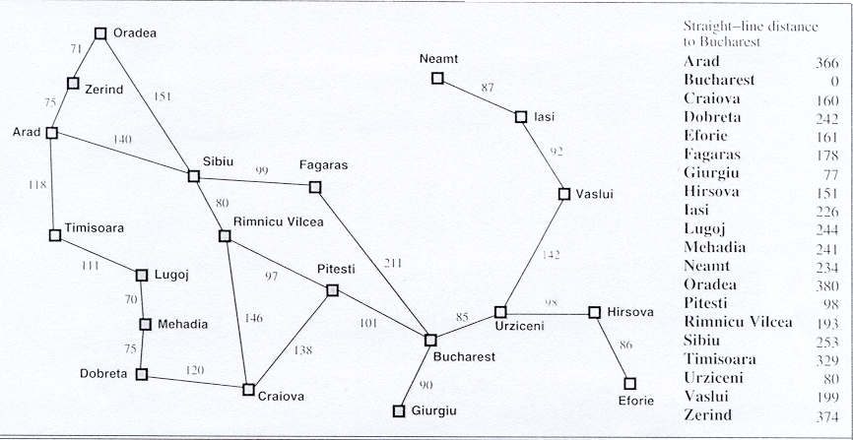
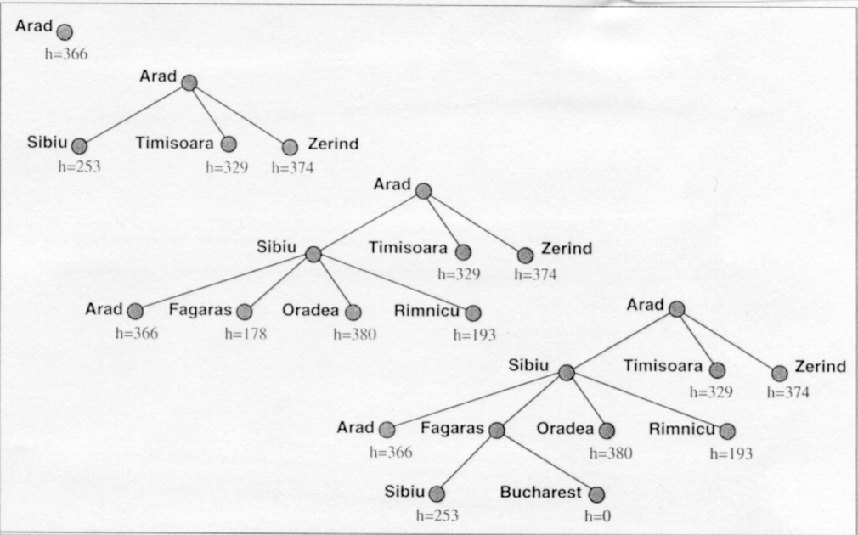
Greedy Search
function GREEDY-SEARCH (problem) returns a solution or failure
return BEST-FIRST-SEARCH (problem, h)
h(n) = estimated cost of the cheapest path from the state at node n to a goal state
178
193
Not Optimal
Incomplete
O(b^{m}) time
O(b^{m}) space
Let h(n) = straight line distance from
the city at node n to the goal.

Slide 6
Beam Search
Use f(n) = h(n) but |nodes| ≤ K (beam width)
Focuses on a few “best” candidates
Avoids exponential time and space costs
Not complete
Not optimal

Slide 7
A* Search…
In a minimization problem, an admissible heuristic h(n) never overestimates the real cost.
(In a maximization problem, h(n) is admissible if it never underestimates the real value.)
So admissible heuristics are optimistic.
Best-first search using f(n) = g(n) + h(n) and an admissible h(n) is known as A* search.
A* tree search is complete & optimal.

Slide 8
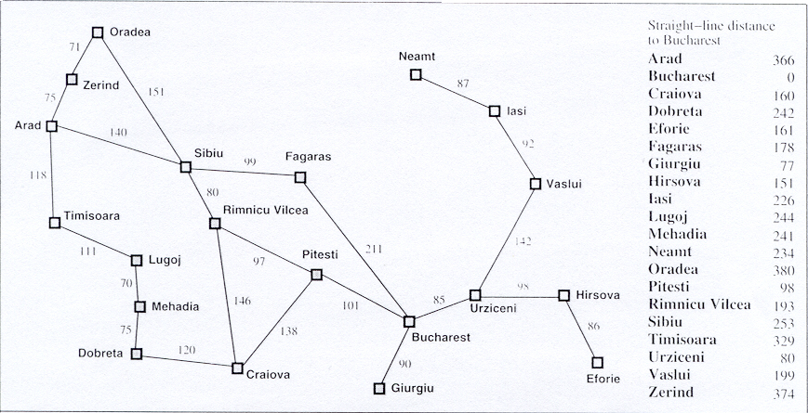
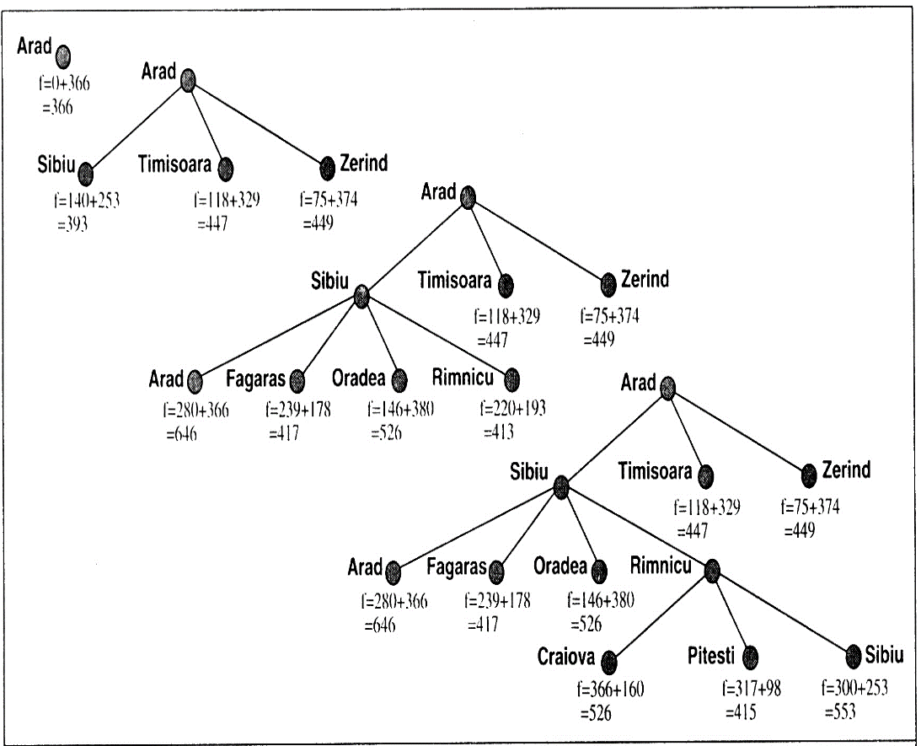
A* Search
function A*-SEARCH (problem) returns a solution or failure
return BEST-FIRST-SEARCH (problem, g+h)
f(n) = estimated cost of the cheapest solution through n
= g(n) + h(n)
= path cost + heuristic estimate of distance to go
f=291+380
=671
f=291+380
=671

Slide 9
Completeness of A*
Because A* expands nodes in order of increasing f, it must eventually expand to reach a goal state. This is true unless there are infinitely many nodes with f(n) ≤ f*.
How could this happen?
There is a node with an infinity branching factor.
There is a path with finite path cost but an infinite number of nodes on it.
So, A* is complete on graphs with a finite branching factor provided there is some positive constant δ such that every operator costs at least δ.

Slide 10
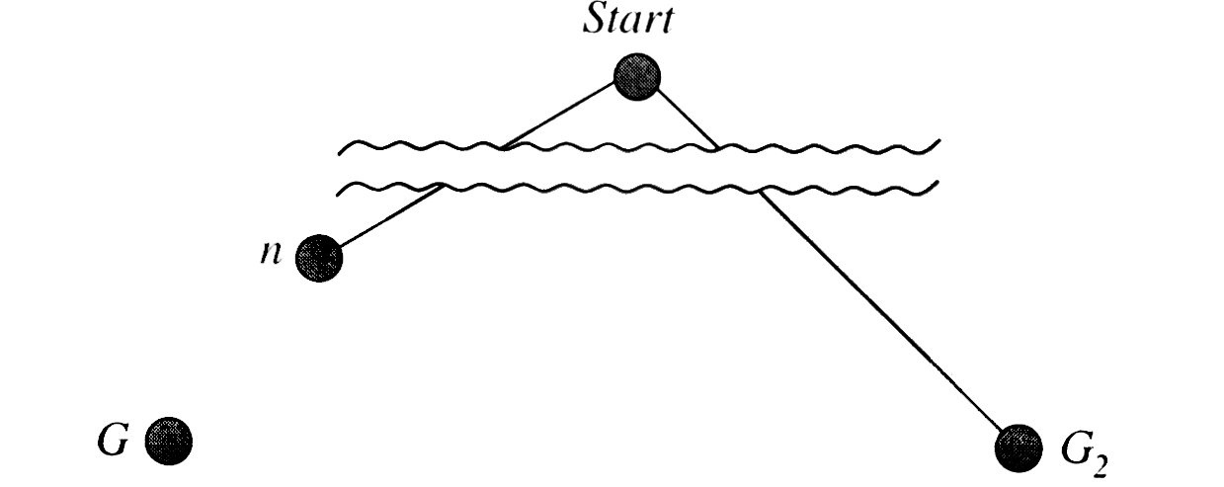
Proof of optimality of A* tree search
Assumes h is admissible, but does not assume h is monotonic
Let G be an optimal goal state, and f(G) = f* = g(G).
Let G₂ be a suboptimal goal state, i.e., f(G₂) = g(G₂) > f*.
Suppose for contradiction that A* has selected G₂ from the queue. This would terminate A* with a suboptimal solution.
Let n be a node that is currently a leaf node on an optimal path to G.
Situation at the point where a sub-optimal goal state G₂ is about to be picked from the queue
f(n)
f(G₂)= g(G₂)
f*
Because h is admissible, f* ≥ f(n).
If n is not chosen for expansion over G₂, we must have f(n) ≥ f(G₂).
So, f* ≥ f(G₂). Because h(G₂)=0, we have f* ≥ g(G₂), contradiction.

Slide 11
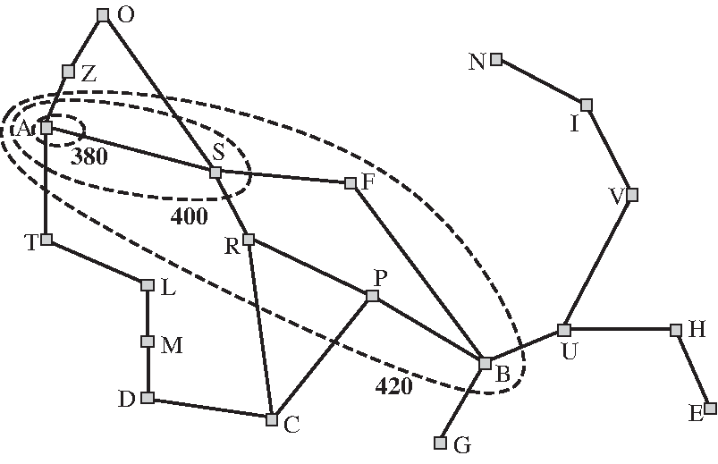
Consistency of a heuristic
h(n) is consistent (aka. monotonic) if, for every node n and every child n’ of n generated by any action a, the estimated cost of reaching the goal from n is no greater than the step cost of getting to n’ plus the estimated cost of reaching the goal from n’: h(n) ≤ c(n,a,n’) +h(n’).
Consistency implies that f(n) (which equals g(n)+h(n)) never decreases along a path from the root.
Consistent => admissible
Advanced topic: “A* Search with Inconsistent Heuristics” in Proceedings of the International Joint Conference on Artificial Intelligence (IJCAI), 2009, provides techniques for making non-monotonic heuristics monotonic
With a consistent heuristic, we can interpret A* as searching through contours:
Map of Romania showing contours at f = 380, f = 400 and f = 420, with Arad as the start state. Nodes inside a given contour have f-costs lower than the contour value.

Slide 12
Consistency of a heuristic…
A* expands all nodes n with f(n) < f*, and may expand some nodes right on the “goal contour” (f(n) = f*), before selecting a goal node.
With a consistent (monotonic) heuristic, even A* graph search (i.e., search that deletes later-created duplicates) is optimal.
Another option, which requires only admissibility, not consistency, is to have the duplicate detector always keep the best (rather than the first) of the duplicates.
A* tree search doesn’t do detection or removal of duplicates.

Slide 13
A* graph search is optimal if h is consistent (admissibility does not suffice)
See proof in Russell & Norvig book p. 95-97.

Slide 14
Complexity of A*
Generally O(b^{d}) time and space.
Absolute error: Δ = h(n) - h*(n)
Sub-exponential growth when |h(n) - h*(n)| ≤ O(log h*(n))
Unfortunately, for most practical heuristics, the error is at least proportional to the path cost

Slide 15
A* is optimally efficient
A* with a consistent heuristic is optimally efficient for any given h-function among algorithms that extend search paths from the root. I.e., no other optimal algorithm is guaranteed to expand fewer nodes (except perhaps on the goal contour where f(n)=f*) (for a given search formulation).
With an inconsistent admissible heuristic, some nodes can be expanded many times, causing the search to do O(2^{N}) node expansions, where N is the number of nodes expanded
Intuition: any algorithm that does not expand all nodes in the contours between the root and the goal contour runs the risk of missing the optimal solution.

Slide 16
How to generate h-functions?

Slide 17
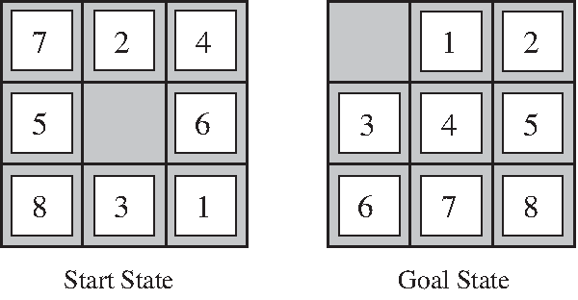
Heuristics (h(n)) for A*
A typical instance of the 8-puzzle
Heuristics?
h₁: #tiles in wrong position
h₂: sum of Manhattan distances of the tiles from their goal positions
h₂ dominates h₁: ∀n, h₂(n) ≥ h₁(n)

Slide 18
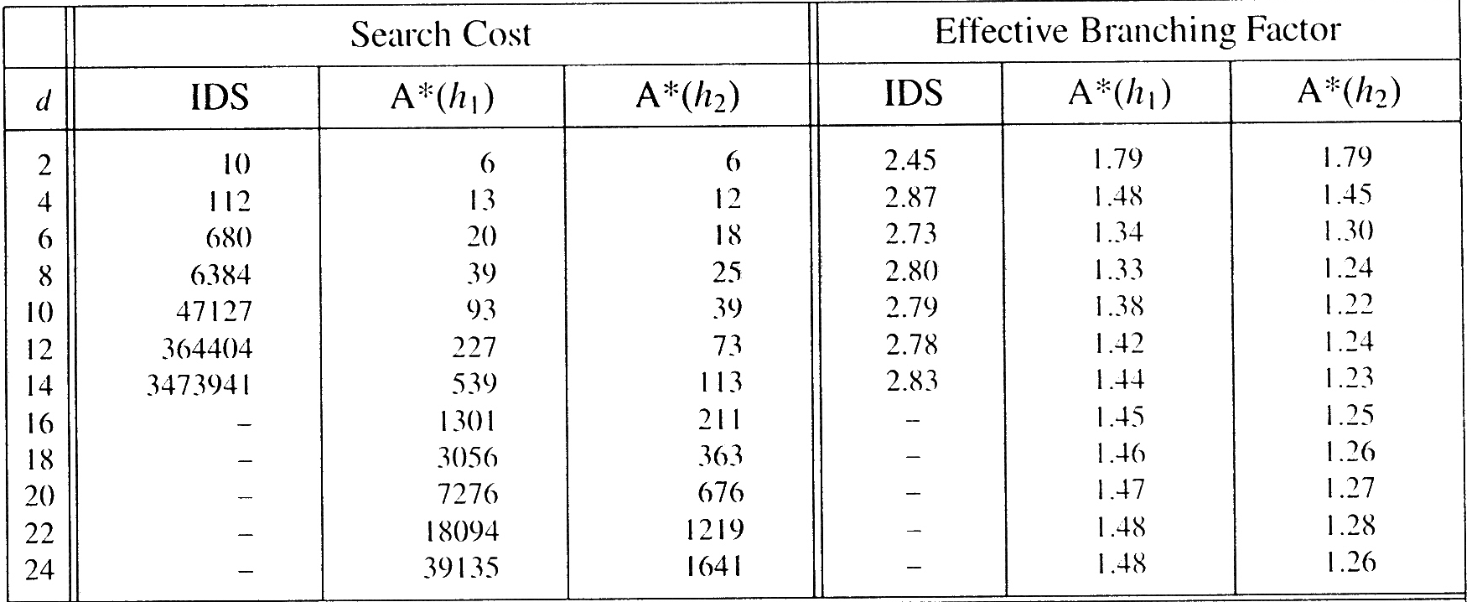
Heuristics (h(n)) for A* …
Comparison of the search costs and effective branching factors for the ITERATIVE-DEPENING-SEARCH and A* algorithms with h1, h2. Data are averaged over 100 instances of the 8-puzzle, for various solution lengths.

Slide 19
Inventing heuristic functions h(n)
Cost of exact solution to a relaxed problem is often a good heuristic for original problem.
Relaxed problem(s) can be generated automatically from the problem description by dropping or relaxing constraints.
Most common example in operations research: relaxing all integrality constraints and using linear programming to get an optimistic h-value.
What if no dominant heuristic is found?
h(n) = max [ h₁(n), … h_{m}(n) ]
h(n) is still admissible & dominates the component heuristics
Use probabilistic info from statistical experiments: “If h(n)=14, h*(n)=18”.
Gives up optimality, but does less search
Pick features & use machine learning to determine their contribution to h.
Use full breadth-first search as a heuristic?
search
time
complexity of computing h(n)

Slide 20
PATTERN DATABASES FOR HEURISTICS
[Culberson & Schaeffer 1996; many improvements since; figures in this segment borrowed from others’ AI courses]

Slide 21
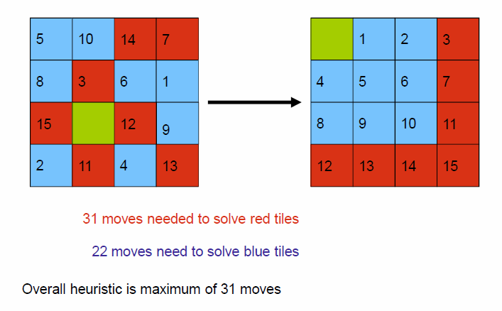
Combining multiple pattern databases
(counting moves of all tiles)
(counting moves of all tiles)
Overall heuristic value is the maximum of these, that is, 31.

Slide 22
Additive pattern databases
Original pattern databases counted all moves (include moves of pieces not in the pattern) to get pattern pieces into their correct places
Additive pattern databases count only moves of the pieces belonging to the pattern and optimize that
Manhattan distance is a special case where each piece is its own pattern
Then, can add the values of the different patterns instead of taking the max
Why? Because having other pieces on the board cannot reduce the number of pattern-piece moves that are needed to get pattern pieces in their right places

Slide 23
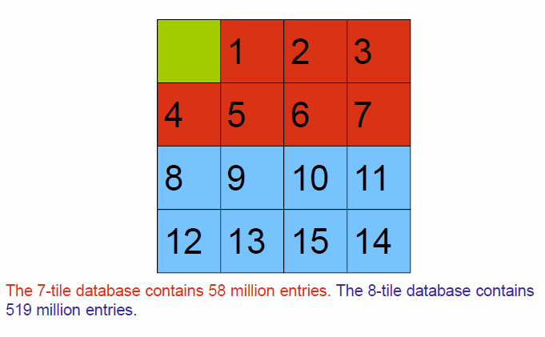
Example: 7-8 pattern database
Note: It doesn’t matter for correctness how one partitions the tiles into disjoint sets for the pattern database.

Slide 24
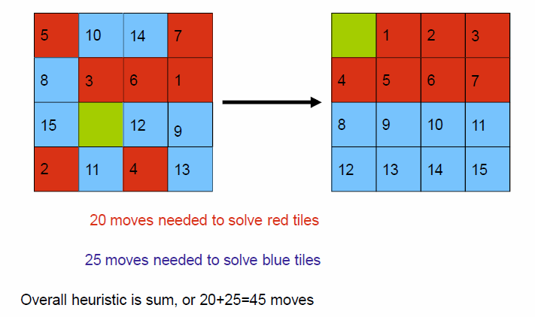
Computing the heuristic value in an additive pattern database
(counting only moves of red tiles)
(counting only moves of blue tiles)

Slide 25
Performance

Slide 26
Dynamic pattern databases
In the database generation phase, use multiple different partitions of the tiles.
In the search phase, in any given search state that is reached, when computing the h-value, try different partitions and pick one that gives the highest h-value.

Slide 27
General template for pattern databases for any application
A pattern is an assignment of values to a subset of the variables in the problem
The database is built via a breadth-first search backward from the goal until each pattern has been observed at least once
(Need to make sure that one move does not help variables in multiple patterns; otherwise cannot add in that part.)

Slide 28
Memory-bounded search algorithms

Slide 29
Iterative Deepening A* (IDA*)
function IDA*(problem) returns a solution sequence
inputs: problem, a problem
static: f-limit, the current f-COST limit
root, a node
root ← MAKE-NODE(INITIAL-STATE[problem])
f-limit ← f-COST(root)
loop do
solution, f-limit ← DFS-CONTOUR(root,f-limit)
if solution is non-null then return solution
if f-limit = ∞ then return failure; end
function DFS-CONTOUR(node,f-limit) returns a solution sequence and a new f-COST limit
inputs: node, a node
f-limit, the current f-COST limit
static: next-f, the f-COST limit for the next contour, initially ∞
if f-COST[node] > f-limit then return null, f-COST[node]
if GOAL-TEST[problem](STATE[node]) then return node, f-limit
for each node s in SUCCESSOR(node) do
solution, new-f ← DFS-CONTOUR(s,f-limit)
if solution is non-null then return solution, f-limit
next-f ← MIN(next-f, new-f); end
return null, next-f
f-COST[node] = g[node] + h[node]

Slide 30
A* vs. IDA*
visited 3x
visited 2x
visited 1x
Map of Romania showing contours at f = 380, f = 400 and f = 420, with Arad as the start state. Nodes inside a given contour have f-costs lower than the contour value.

Slide 31
Question: When is IDA* a good idea?
When the branching factor is small
When the branching factor is large

Slide 32
IDA* …
Complete & optimal under same conditions as A*. Linear space. Same O( ) time complexity as A*.
If # nodes grows exponentially, then asymptotically optimal space.

Slide 33
IDA* …
Effective e.g. in 8-puzzle where f typically only increases 2-3 times → 2-3 iterations.
Last iteration ~ A*
Ineffective in, e.g., TSP where f increases continuously
each new iteration only includes one new node.
If A* expands N nodes, IDA* expands O(N²) nodes
Fixed increment ε → ~1/ε iterations
Obtains ε-optimal solution if terminated once first solution is found
Obtains an optimal solution if search of the current contour is completed

Slide 34
Memory-bounded search algorithms
}^{use “too little” memory}
IDA* 1985
Recursive best-first search 1991
Memory-bounded A* (MA*) 1989
Simple memory-bounded A* (SMA*) 1992 …

Slide 35
Simple Memory-bounded A* (SMA*)
Search space
Progress of SMA* (with enough memory to store just 3 nodes). Each node is labeled with its current f-cost. Values in parentheses show the value of the best forgotten descendant.
f = g+h
• = goal
A
13(15)
A
A
A
A
12
12
13
0+12=12
G
13
10
8
B
G
B
B
G
10+5=15
8+5=13
15
18
15
13
∞
H
10
10
8
16
C
D
H
I
A
A
A
20+5=25
16+2=18
15(15)
15(24)
20(24)
20+0=20
24+0=24
A
8
10
10
8
8
E
F
J
K
15
B
B
G
15
20(∞)
24(∞)
30+5=35
30+0=30
24+0=24
24+5=29
B
G
I
15
24
C
25
D
24
∞
20
Optimal & complete if enough memory
Can be made to signal when the best solution found might not be optimal (e.g., if J=19)

Slide 36
SMA* pseudocode (from 1st edition of Russell & Norvig)
Numerous details have been omitted in the interest of clarity
function SMA*(problem) returns a solution sequence
inputs: problem, a problem
static: Queue, a queue of nodes ordered by f-cost
Queue ← MAKE-QUEUE({MAKE-NODE(INITIAL-STATE[problem])})
loop do
if Queue is empty then return failure
n ← deepest least-f-cost node in Queue
if GOAL-TEST(n) then return success
s ← NEXT-SUCCESSOR(n)
if s is not a goal and is at maximum depth then
f(s) ← ∞
else
f(s) ← MAX(f(n),g(s)+h(s))
if all of n’s successors have been generated then
update n’s f-cost and those of its ancestors if necessary
if SUCCESSORS(n) all in memory then remove n from Queue
if memory is full then
delete shallowest, highest-f-cost node in Queue
remove it from its parent’s successor list
insert its parent on Queue if necessary
insert s in Queue
end

Slide 37
Local Search

Slide 38
Hill Climbing
Evaluation function assigns a value to each state.
Each state has a set of neighbors a small “distance” away.
We only care about finding a goal state, not the path.
Hill Climbing search method -- greedy local search:
maintain a single “best” state
look only at the neighbors of the current best state
select the best neighbor if it’s better than or equal to the current best state
stop when all neighbors are worse than current best

Slide 39
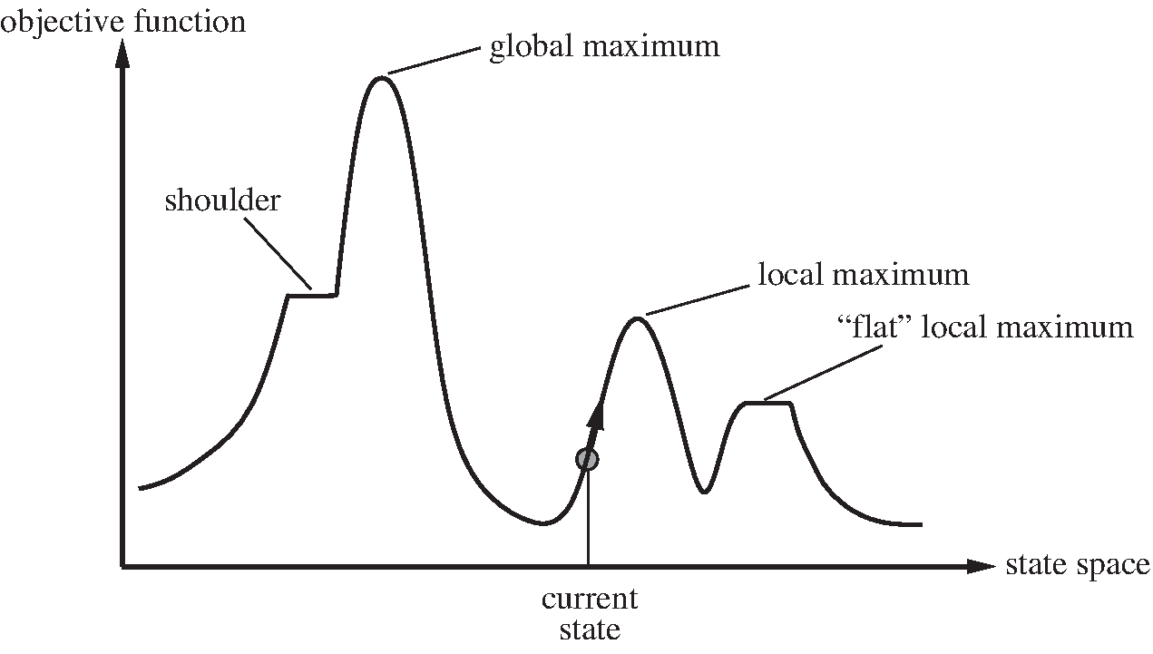
Local Maxima and Plateaus

Slide 40
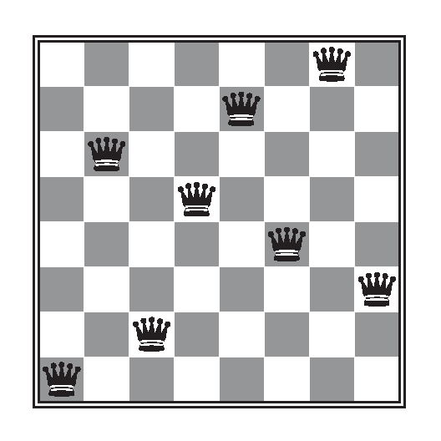
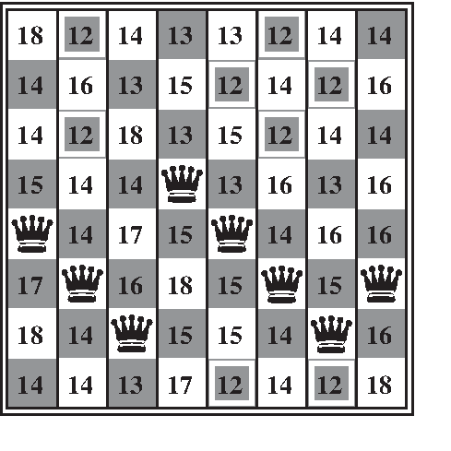
Hill Climbing in 8 Queens
Best neighbors of current state (h=17) have h=12.
Local minimum state: h=1, and every neighbor has h > 1.
Hill climbing can fail if the state space isn’t monotonic.
Random-restart hill climbing: if plateau is reached, pick new start state at random and search again.
Can solve 3,000,000 queens in < 1 minute!
But NP-hard problems have lots of local maxima, so failure rate can be prohibitively high.

Slide 41
Stochastic Gradient Descent
If we’re minimizing error instead of maximizing value, hill climbing is called gradient descent. Can get stuck in local minima.
Stochastic gradient descent = gradient descent with (some) uphill moves.
Take the best downhill direction if possible.
Else select an uphill move with some probability p based on how far uphill.

Slide 42
Simulated Annealing
How tolerant should we be of uphill moves?
Simulated annealing:
Temperature parameter T governs willingness to move uphill.
High T = big uphill moves allowed.
Low T = only small uphill allowed.
Start at high T and gradually lower it.
Analogous to annealing in metallurgy.
High probability of finding global minimum if we anneal slowly enough.

Slide 43
Uses of Simulated Annealing
VLSI layout optimization
Place chip modules to minimize wire length.
A “move” might swap two modules.
Boltzmann Machines: neural networks whose units have binary states.
“Energy” is a function of the weights between pairs of active nodes.
Use simulated annealing to find minimum energy states.

Slide 44
Other Local Search Methods
Local beam search
Generate k random starting states.
At each step, find all successors and take the k best ones.
Genetic algorithms
Maintain a population of candidates.
Generate new candidates by a combination of crossover and random mutation.
Crossover combines parts of two parent states to make a successor state.

Slide 45
Genetic Search in 8 Queens

Slide 46
Additional Slides
(not required for this lecture)

Slide 47
Approximate A* versions (less search effort, but only an approximately optimal solution)
Dynamic weighting:
f(n) = g(n) + h(n) + α [1- (depth(n) / N)] h(n)
where N is (an upper bound on) depth of desired goal.
Idea: Do more focused search early on in the search.
Thrm: Solution is within factor (1+ α) of optimal.
A_{β}*:
From open list, choose among nodes with f-value within a factor (1+β) of the most promising f-value.
Thrm: Solution is within factor (1+β) of optimal
Make the choice based on which of those nodes leads to lowest search effort to goal (sometimes picking a node with best h-value accomplishes this)

Slide 48
Best-bound search
A* search was invented in the AI research community
Best-bound search was invented in the operations research community
Same node selection strategy as A*
…but for a different setting: not a given graph to search as in A*, but integer programming where one can decide which variable to branch on at every point in the search tree (like in CSPs)
In practice, not exactly A* node selection is used. With heavy-to-compute h-heuristics such as LP, commercial integer programming solvers:
Use parent’s f value to queue nodes on the open list, and only evaluate nodes exactly if they come off the open list
=> first solution may not be optimal
=> need to continue the search until all nodes on the open list look worse than the best solution found
Do diving. In practice there is usually not enough memory to store the LP data structures with every node. Instead, only one LP table is kept. Moving to a child or parent in the search tree is cheap because the LP data structures can be incrementally updated. Moving to another node in the tree can be more expensive. Therefore, when a child node is almost as promising as the most-promising (according to A*) node, the search is made to proceed to the child instead.
Again, need to continue the search until all nodes on the open list look worse than the best solution found

